Slide 1
Public Engagement
+ Partnerships

Slide 2
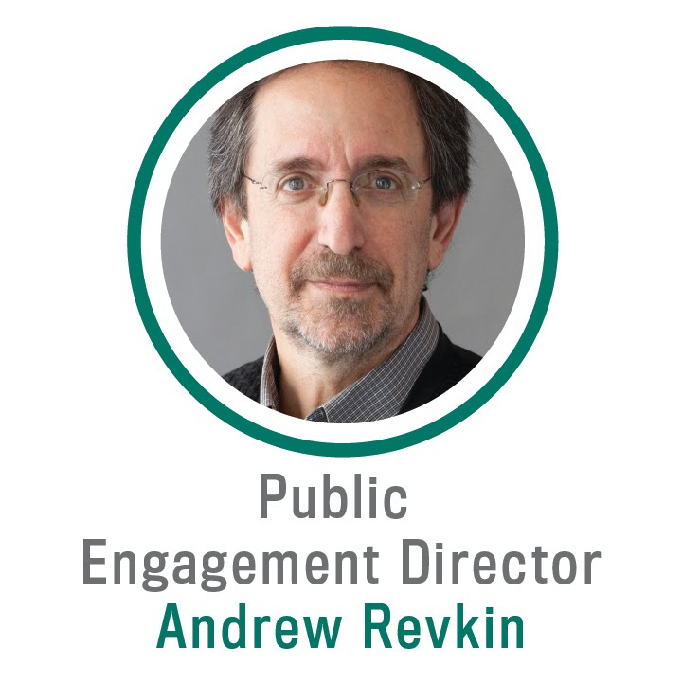
Founding Director, Initiative on Communication + Sustainability, Earth Institute, Columbia
MS, Journalism, Columbia
Expertise
  35 years of climate journalism
  Sustainable development
  Blogging + social media (teaching, training)
Other Synergistic Experience
  Strategic Advisor, Science Journalism, National Geographic
  Reporter, Blogger, The New York Times, 1995-2016
  Member, Anthropocene Working Group, 2010-2016
  AGU Career Science Journalism Award, 2015
  NAS Communication Awards, 2003, 2011
  NAS Climate Communication Initiative Committee

Slide 3

Our Roadmap
LEAP forward in the reliability, utility, and reach of climate projections through synergistic innovations in data science and climate science.

Slide 4
My Presentation Will Explain:
Why + how LEAP promotes bidirectional knowledge exchange with public + media stakeholders
The role + integration of partners for public + media impact
How this activity propels LEAP toward its Knowledge Transfer objectives

Slide 5
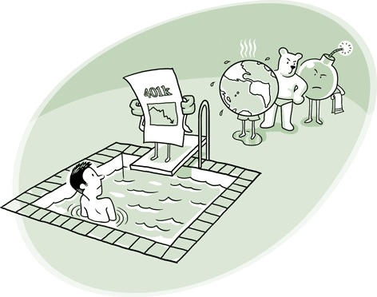
30 Years of Climate Communication Had Minimal Impact on Climate Response
We swim in a “Finite Pool of Worry”
  Climate warning competes with realtime challenges
  People need access to actionable data + knowledge
People are Different
  Cultural values shape risk perceptions + responses
  Climate science literacy does not correlate with climate change concern *
Engagement Emerges via Convergence
  Diverse stakeholders require diverse dialogues
  Communicators must understand the science of diversity
  Climate science + data science must connect

Slide 6
Public Stakeholders Need Early Bidirectional
Data Dialogue
Shapes inquiry + output for diverse stakeholders
Builds trust + understanding in emerging fields amid polarizing debate
Forges new pathways to broadening participation in climate data science
Empowers vulnerable communities through access to actionable data

Slide 7
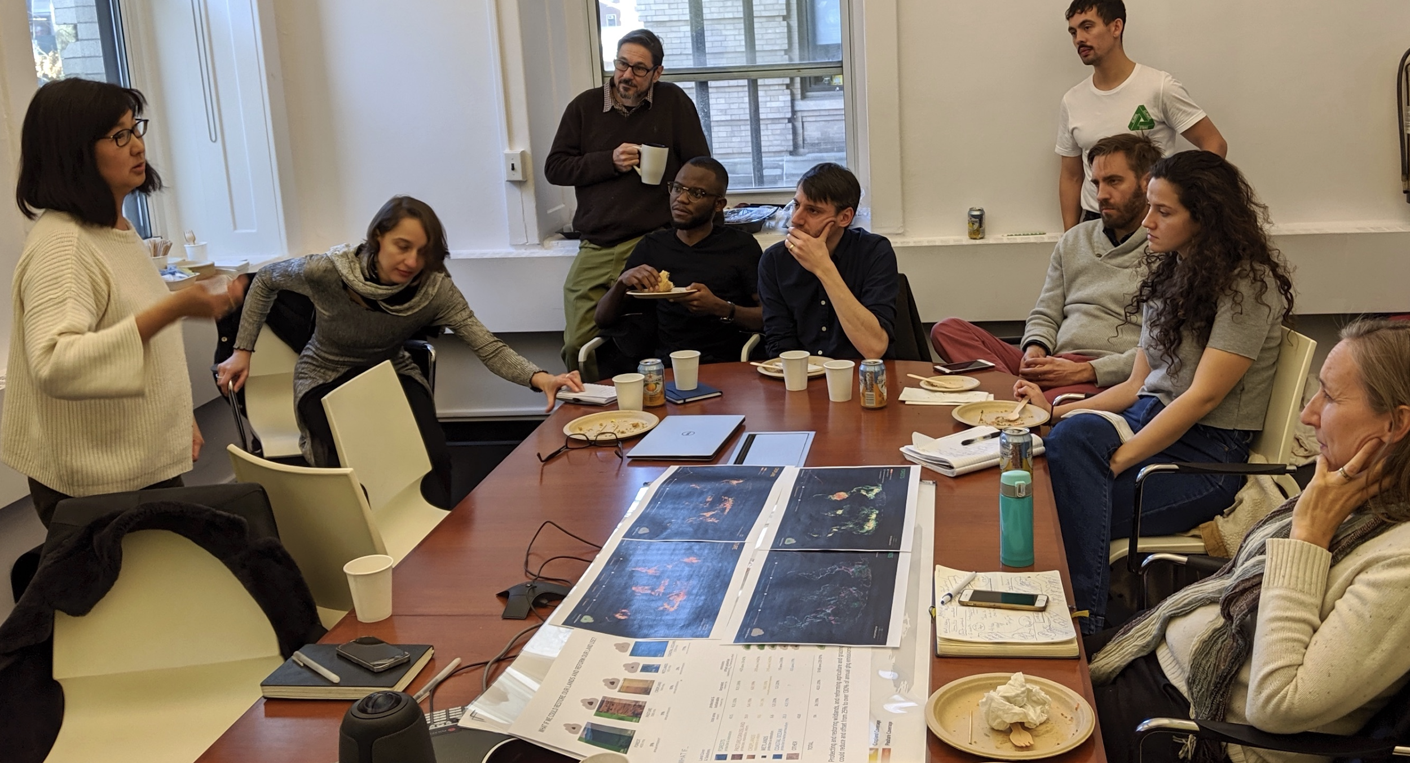
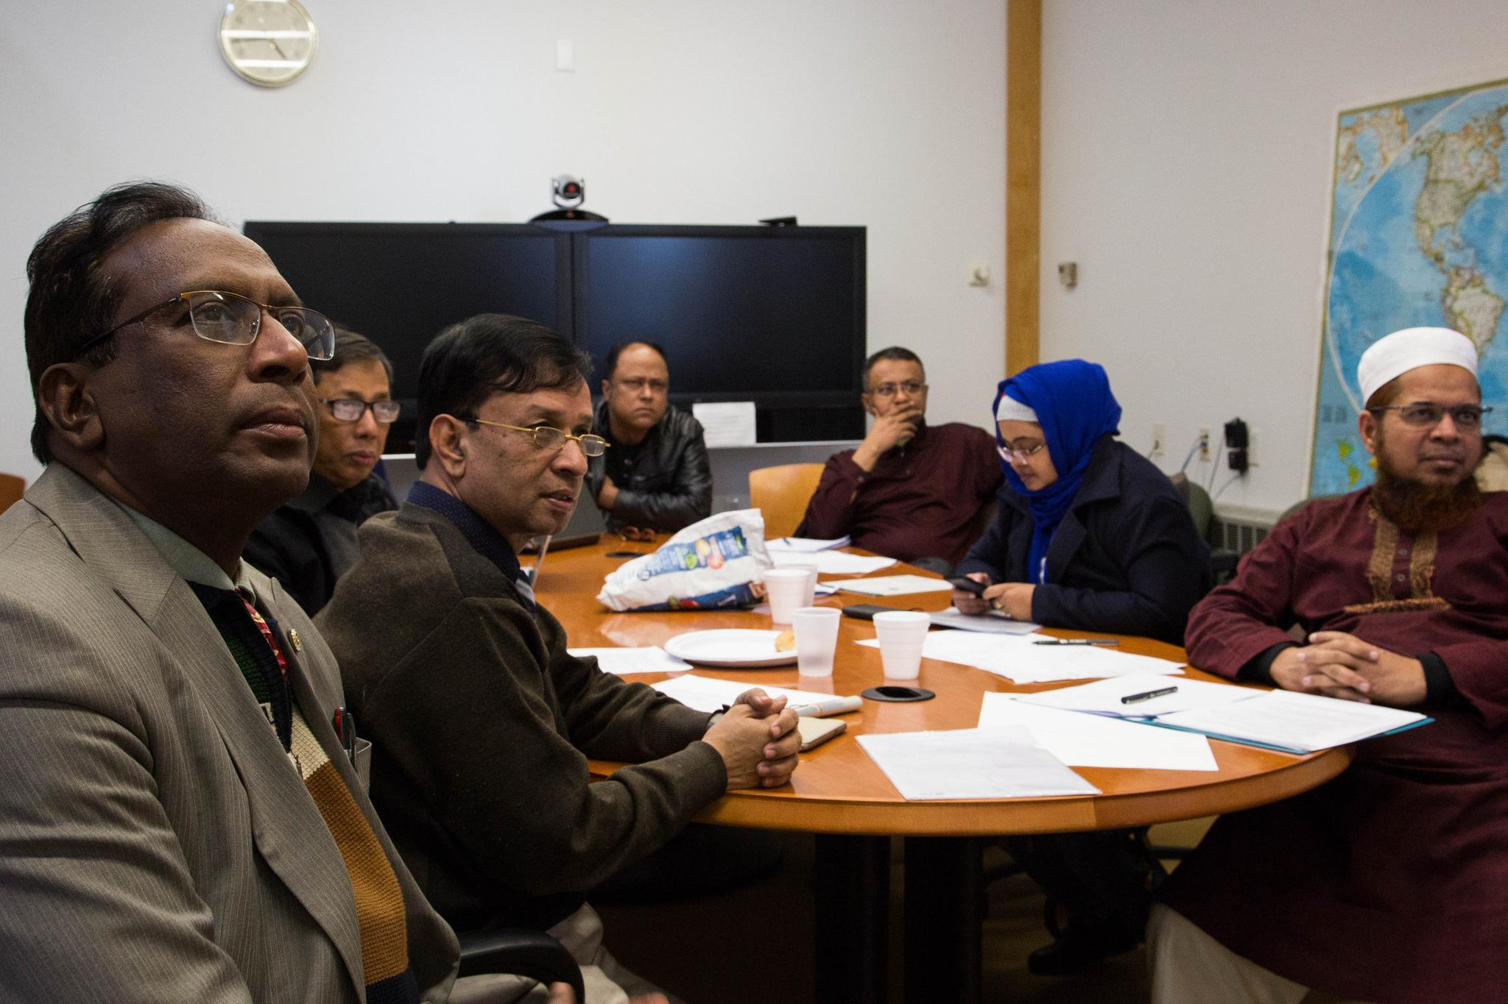
Public Stakeholders Need Early Bidirectional
Data Dialogue
Shapes inquiry + output for diverse stakeholders
Builds trust + understanding in emerging fields amid polarizing debate
Forges new pathways to broadening participation in climate data science
Empowers vulnerable communities through access to actionable data
Columbia Earth Institute Brainstorming Session:
Maya Lin, Designer
Columbia Earth Institute Training Workshop: Bangladesh Meteorological Department

Slide 8
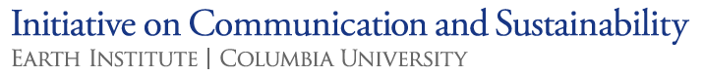
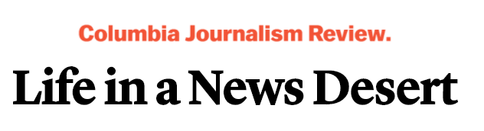
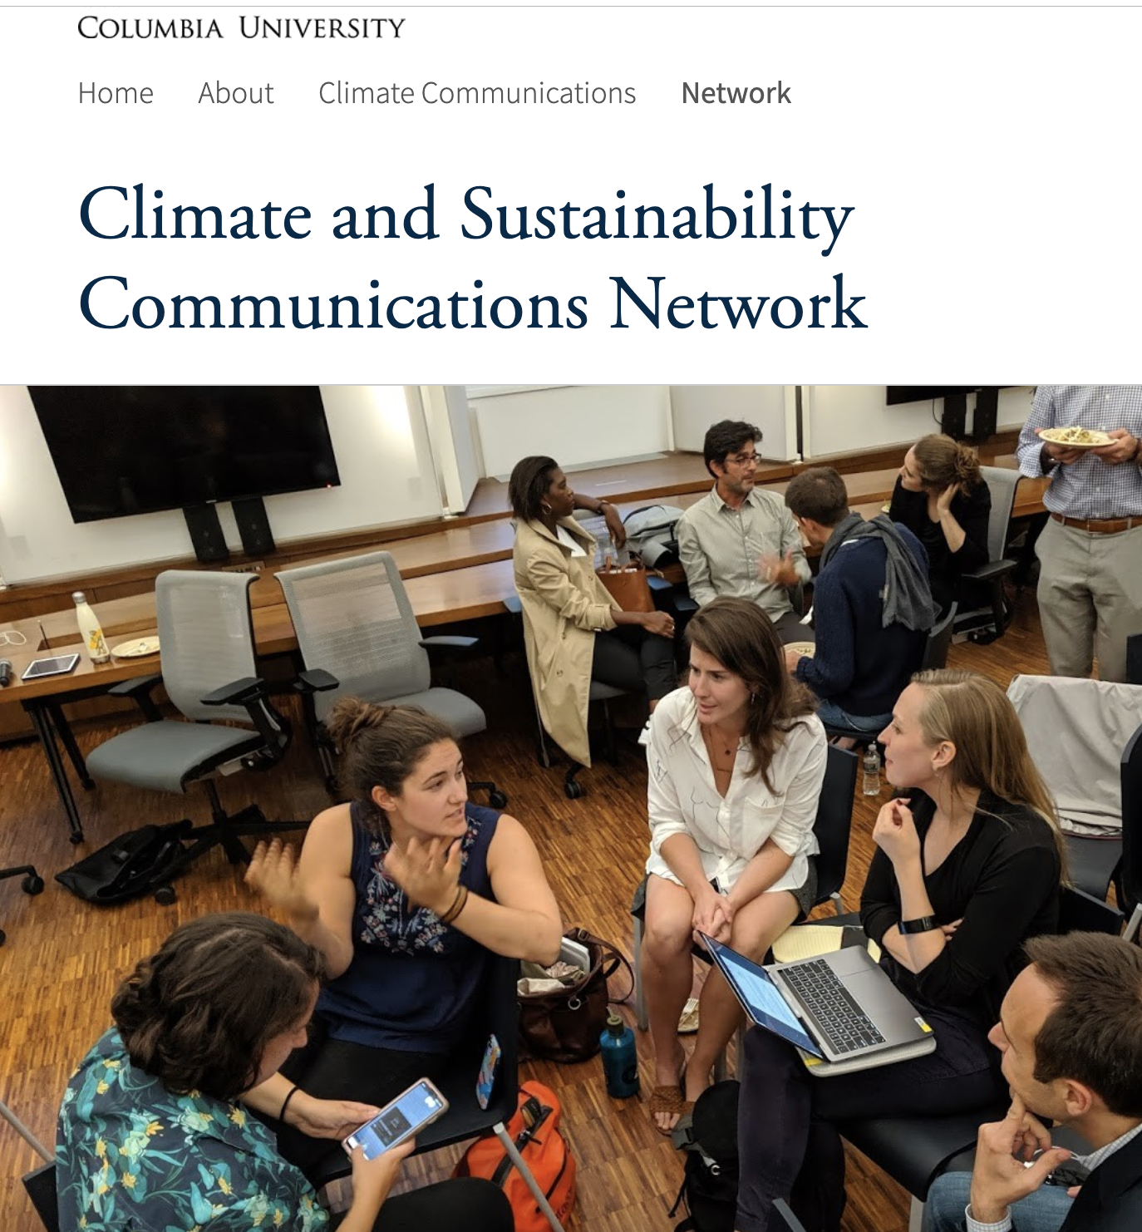

Media Also Need Early Bidirectional
Data Dialogue
  Newsroom capacity is plunging
    “News deserts” spread where climate
    insights are most critical
  Off-Deadline Engagement
    Builds convergent relationships
    Supports innovative translation capacities
    Creates fluency for when news breaks
  Early efforts promising *

Slide 9
Three Knowledge Transfer Goals Guide LEAP’s Public Engagement
KTO1: Establish a bidirectional dialogue between academia, industry, non-profits + the public.
KTO2: Innovate in storytelling, visualization + social media for broad stakeholder intake.
KTO3: Make all LEAP research open-source + broadly accessible.

Slide 10



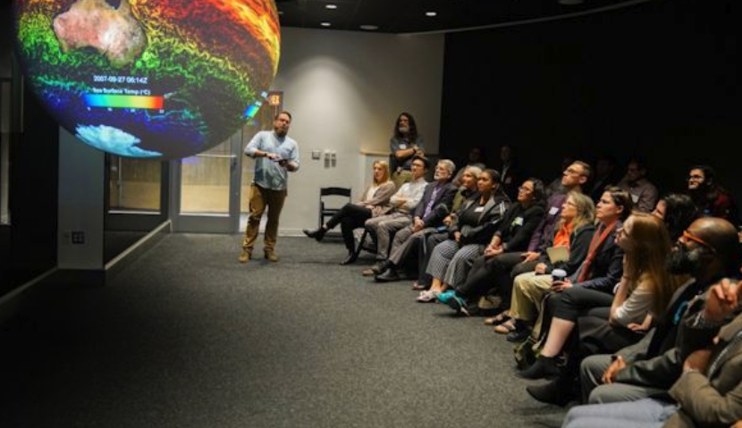
KTO1: Annual Workshop Engages Journalists + Practitioners in Climate Data Science
Full-day event for LEAP researchers, journalists, public communicators, city planners + public
Key Priorities
  Data literacy + LEAPangeo access
  Integrating climate modeling into urban design + planning
  DEI in Everything
  Urban + regional resilience
  Establishing co-production community
Attendees recruited by UCCRN, Climate Central + Earth Journalism Network
Administered by Knowledge Transfer Program Manager + Staff Writer

Slide 11
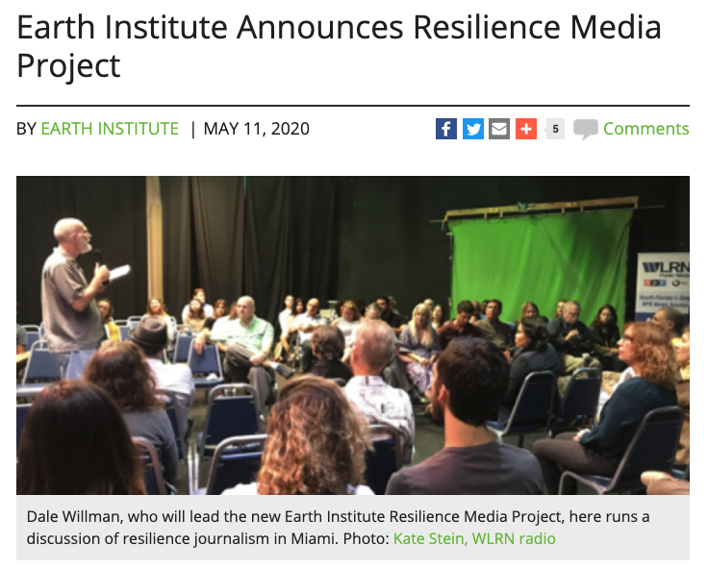
KTO1: Journalism Fellowships Train Reporters in Climate Innovations
Yearlong + Online Fellowships
  3 per year, potentially more after
  Learn risk quantification, data science + solution mapping
    Educated via DEI in Everything
  Engage communities facing high climate risk
  Mentored by Earth Institute
  Stories amplified through EI’s Resilience Media Project
Fellows recruited by Climate Central + Earth Journalism Network

Slide 12
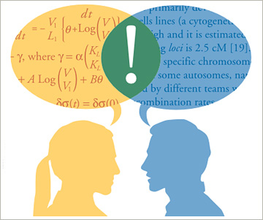
KTO1: Convergence Luncheons Facilitate Internal Collaboration
6 Convergence Luncheons per year for LEAP researchers, trainees + partners
Forge shared vocabulary across climate science, data science, social science + outreach
Lightning research talks spark discussion
Knowledge Transfer Program Manager publishes meeting reports to website
Planned by Assistant Director for Inclusive Education

Slide 13
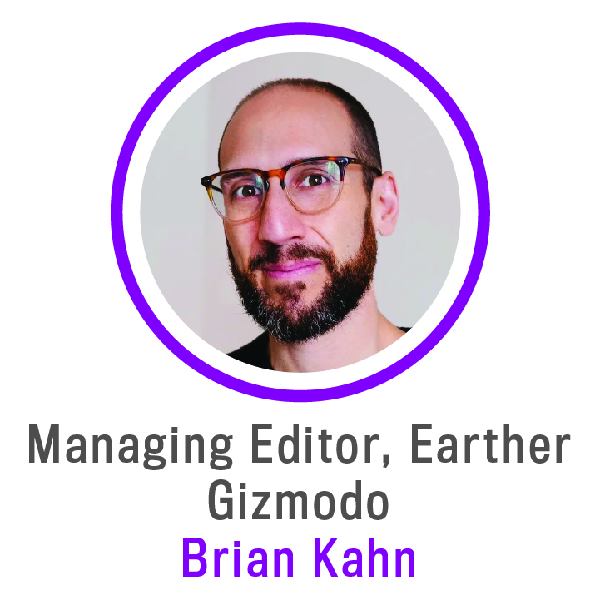

KTO1+2: Storytellers in Residence Spur Communication Innovations + Transparency
Harlem-based artists, writers, or journalists embed for semester
  Working space in LEAP headquarters
  Inaugural Storyteller: Brian Kahn, Gizmodo
  Future Storytellers: Selected by Knowledge Transfer Subcommittee
Activities + Responsibilities
  Translate research processes + products to external stakeholders
  Acquire climate data science literacy
  Support Staff Writer in developing content for broad dissemination
  Join Knowledge Transfer Subcommittee ex officio

Slide 14

KTO1+2: Storytellers in Residence Spur Communication Innovations + Transparency
Harlem-based artists, writers, or journalists embed for semester
  Working space in LEAP headquarters
  Inaugural Storyteller: Brian Kahn, Gizmodo
  Future Storytellers: Selected by Knowledge Transfer Subcommittee
Activities + Responsibilities
  Translate research processes + products to external stakeholders
  Acquire climate data science literacy
  Support Staff Writer in developing content for broad dissemination
  Join Knowledge Transfer Subcommittee ex officio
Prior Storyteller in Residence: Mary Heglar

Slide 15



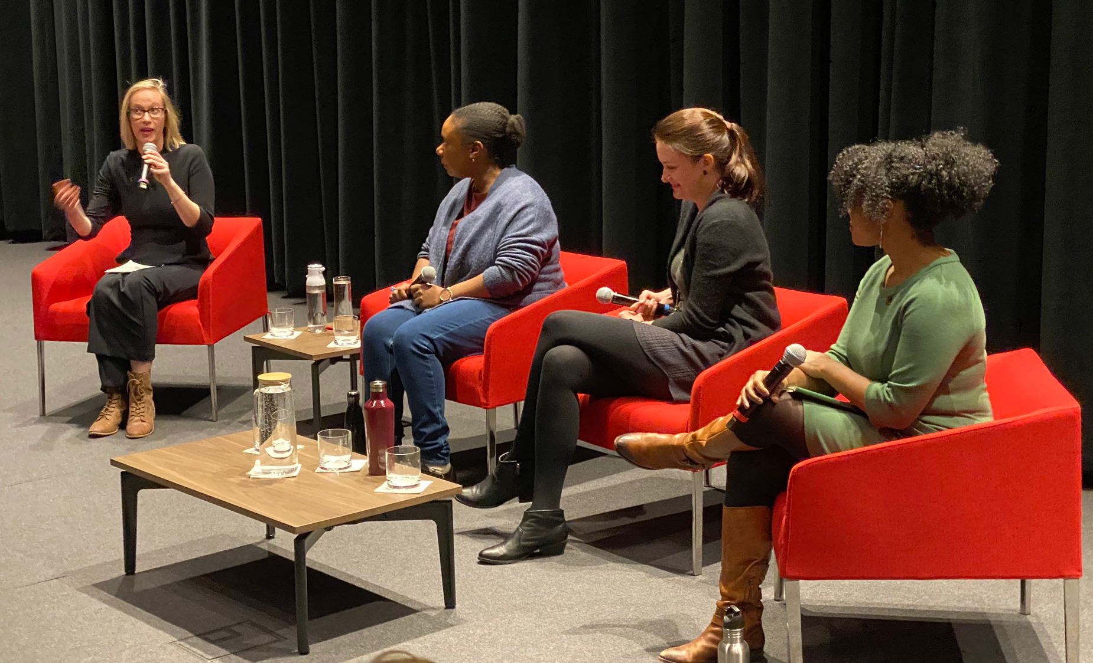
KTO1: Public Conversations Facilitate Discussion between Diverse Audiences + Climate Data Scientists
Four Public Conversations in Climate Data Science per year
Co-administered by Columbia’s Center for Science + Society, Climate Justice Leadership Board
Invited Audiences
  Climate data scientists
  Social scientists
  Journalists
  Teachers + parents from education programs
  Policy + business scholars
  General public
Each Event
  Features cross-disciplinary panel
  200 attendees in-person, 500 live-streaming
  Events live-tweeted + recorded
    Recordings posted to website + YouTube

Slide 16
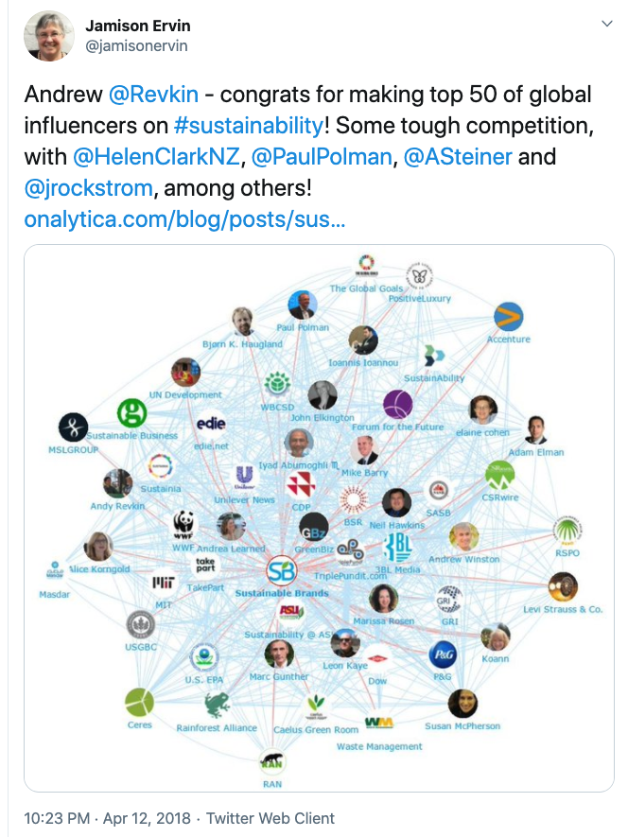


KTO2: Social Media Innovations Experiment with New Engagement Mechanisms
Public initiates dialogue + questions with LEAP faculty
“Ask Me Anything” on Reddit, Twitter + Instagram
  Hashtag: #climateLEAP
LEAP’s Dedicated Administrators
  Support content generation
  Organize interviews
  Transcribe responses
  Moderate digital venues

Slide 17


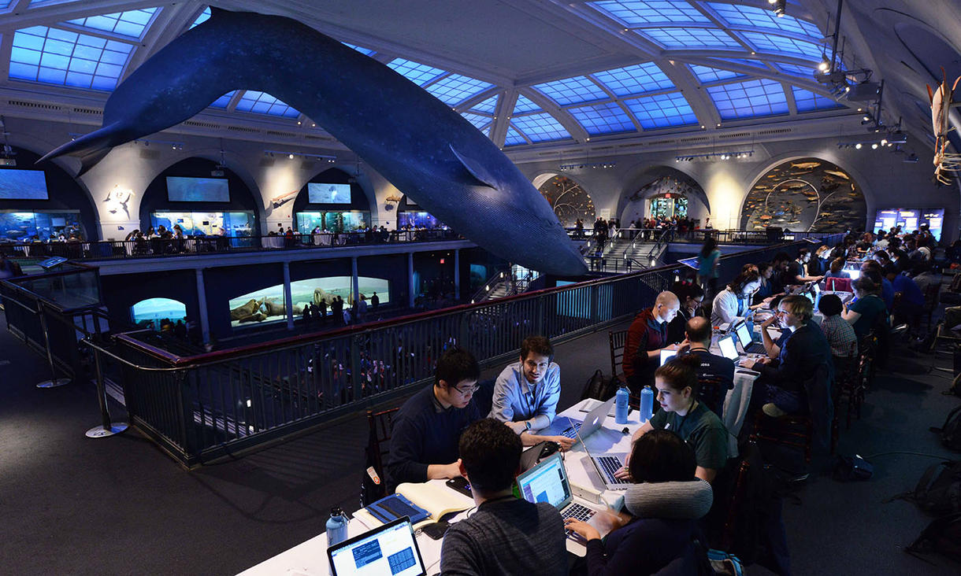
KTO2: Translate-a-thons Train Students + Partners in Science Communications
Quarterly, half-day sessions on scientific translations
LEAP faculty + trainees + partners collaboratively develop:
  Visualizations
  Videos
  Interactive web tools
Co-hosted by Gizmodo, BlackSpace + AMNH
Events guided by list of existing knowledge needs
Supported by Assistant Director + Program Manager

Slide 18
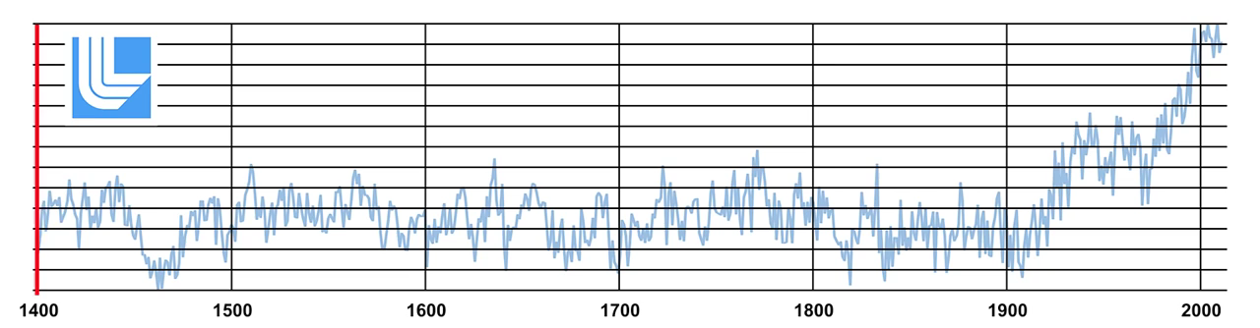
KTO2: Translate-a-thons Train Students + Partners in Science Communications
Quarterly, half-day sessions on scientific translations
LEAP faculty + trainees + partners collaboratively develop:
  Visualizations
  Videos
  Interactive web tools
Co-hosted by Gizmodo, BlackSpace + AMNH
Events guided by list of existing knowledge needs
Supported by Assistant Director + Program Manager
@CarbonWrangler of
@ColumbiaUEnergy

Slide 19
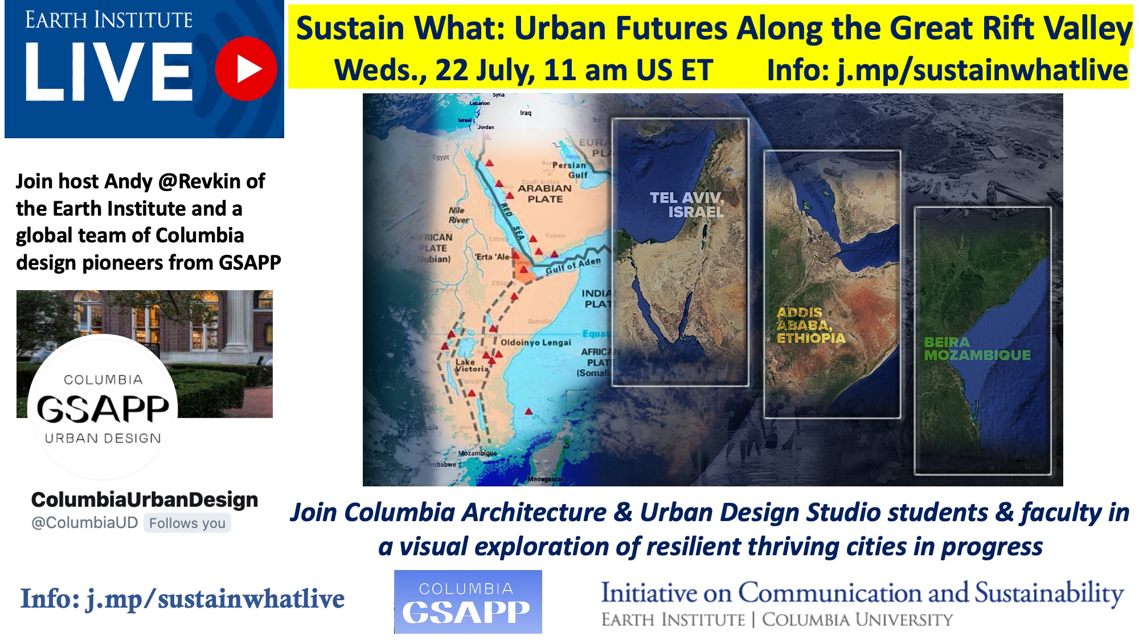
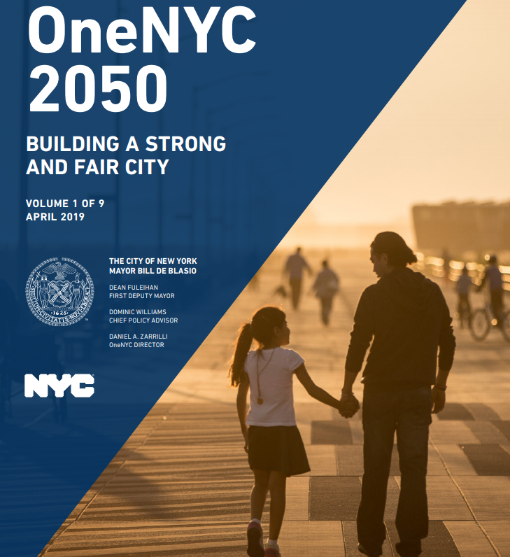
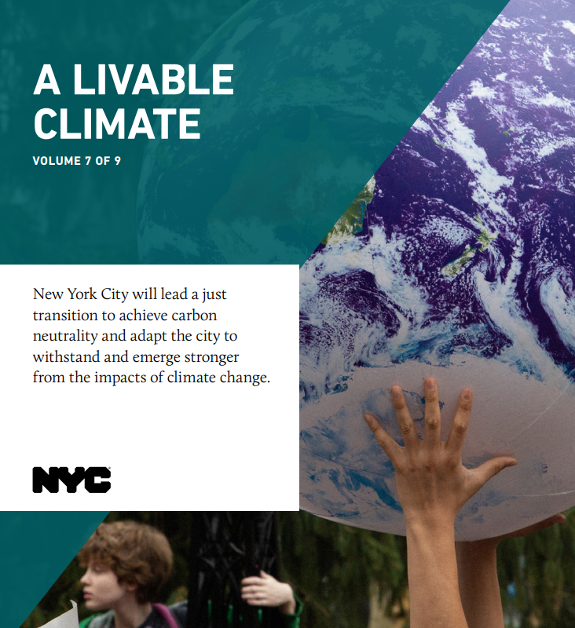

KTO2: Leveraging Existing Programs + Relationships Accelerates Broadest Impact
Earth Institute’s Sustain What? Webcasts
  85 episodes
  250k viewers
Earth Institute blog, website + events amplify LEAP
“Covering Climate Now”:
Columbia Journalism Review program + blog
Digital Storytelling Lab
NYC Office of the Mayor: Leverage LEAP research for OneNYC 2050, NYC’s long-term strategic plan

Slide 20
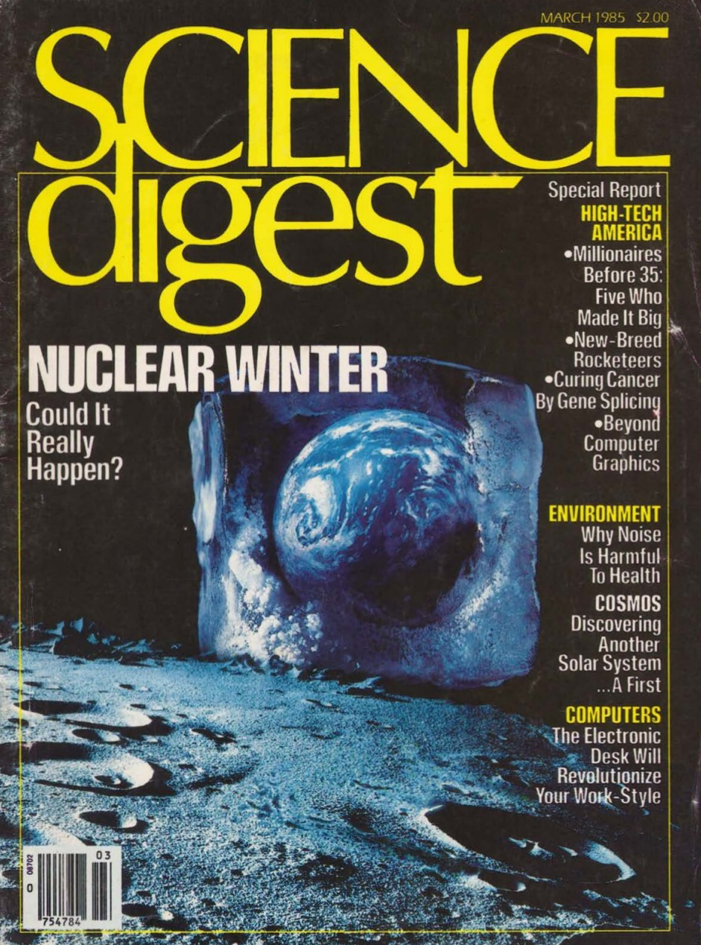
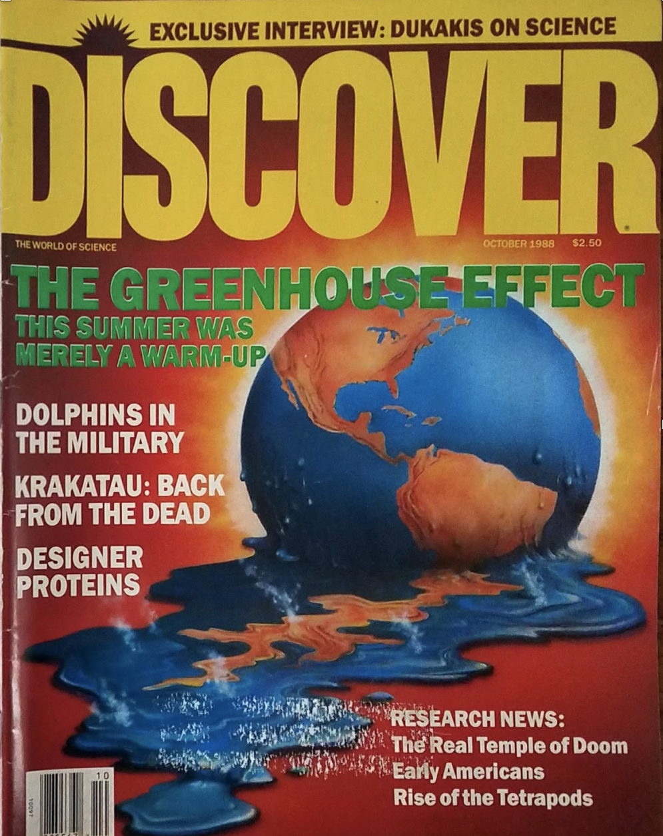
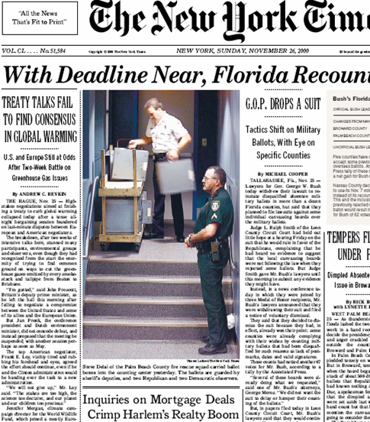
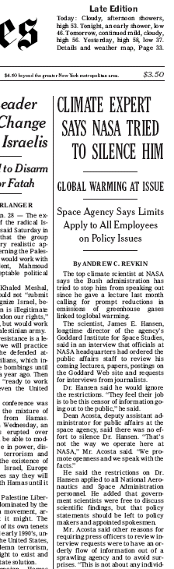
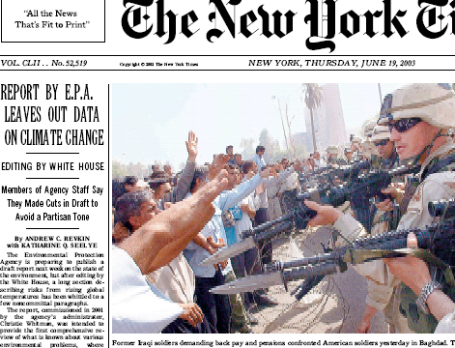
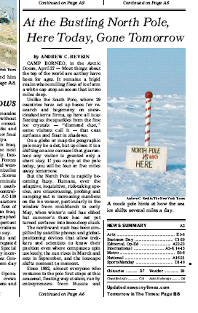
My Career Tracks the Switch from Unidirectional to Bidirectional Communications
LEAP’s opportunity is illustrated in this shift
1985 1988 1995-2009

Slide 21
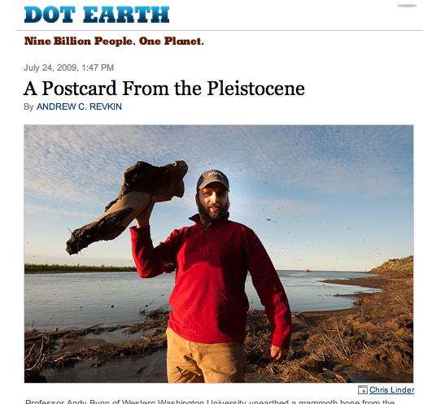
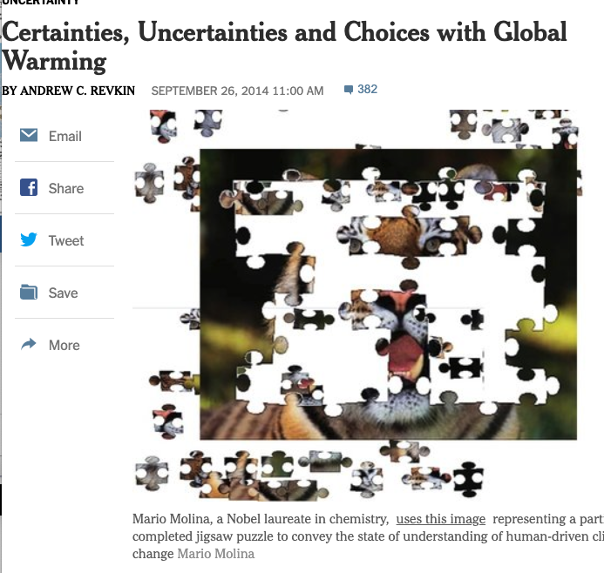
My Career Tracks the Switch from Unidirectional to Bidirectional Communications
LEAP’s opportunity is illustrated in this shift
1985 1988 1995-2009 2007-2016

Slide 22
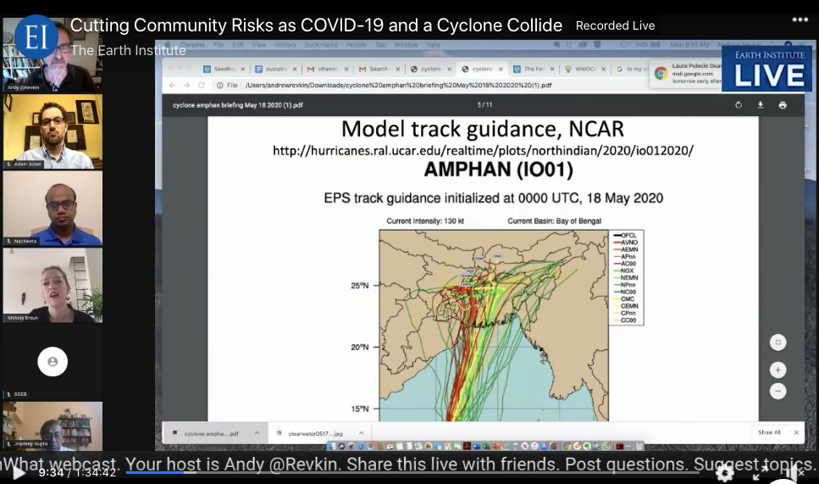
My Career Tracks the Switch from Unidirectional to Bidirectional Communications
LEAP’s opportunity is illustrated in this shift
1985 1988 1995-2009 2007-2016 2020

Slide 23
Questions?
Feedback?

